Slide 1
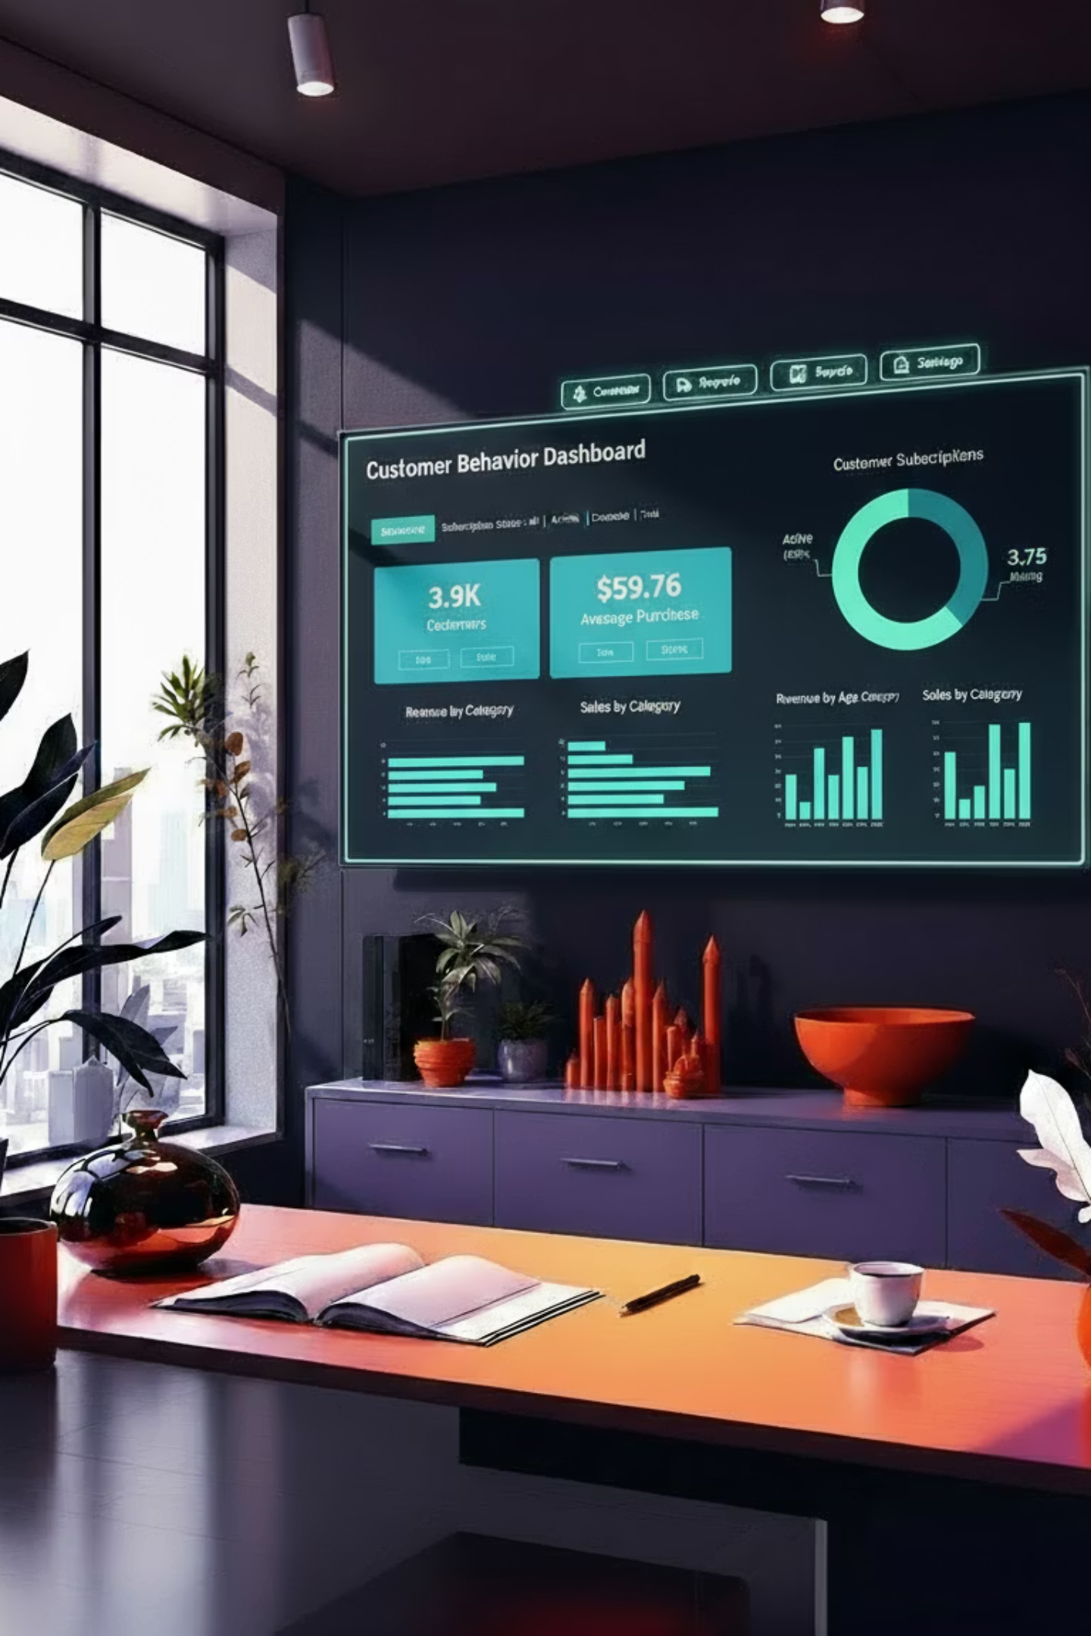
Customer Shopping Behavior Analysis
Analyzing 3,900 purchases to uncover insights into spending patterns, customer segments, and product preferences that drive strategic business decisions.

Slide 2
Dataset Overview
3,900
18
37
Total Purchases
Data Columns
Missing Values
Transactions analyzed across various product categories
Features covering demographics, purchases, and behavior
Only in Review Rating column, handled via imputation
Customer Data
Purchase Details
Age, Gender, Location
Item, Category, Amount
Subscription Status
Season, Size, Color
Previous Purchases
Discounts & Shipping

Slide 3

Data Preparation in Python
01
Data Loading & Exploration
Imported dataset using pandas, examined structure with df.info() and summary statistics
02
Missing Data Handling
Imputed Review Rating nulls using median rating per product category
03
Feature Engineering
Created age_group bins and purchase_frequency_days columns for deeper analysis
04
Database Integration
Connected to PostgreSQL and loaded cleaned data for SQL analysis

Slide 4
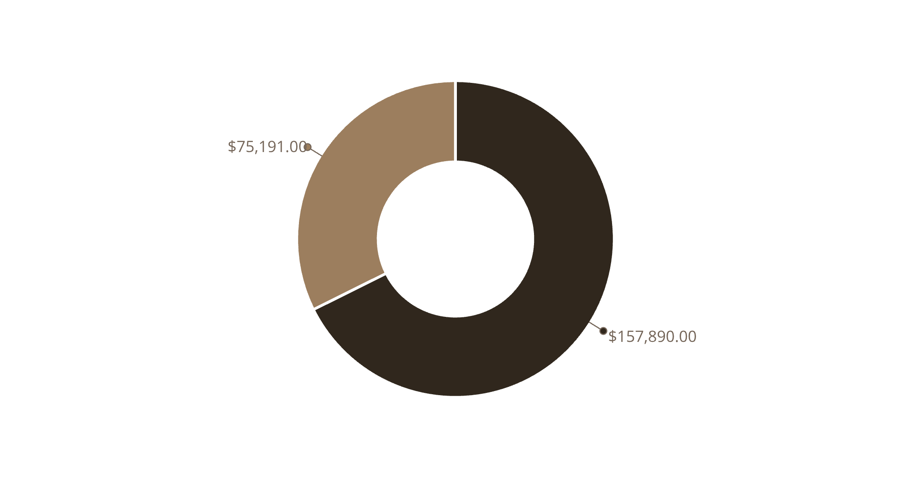
Revenue by Gender
Male customers generate $157,890 in revenue compared to $75,191 from female customers.
This 68% male revenue share suggests opportunities for targeted marketing to balance customer acquisition.
Male
Female

Slide 5


Key Business Insights
Top-Rated Products
Shipping Preferences
Gloves (3.86), Sandals (3.84), and Boots (3.82) lead in customer satisfaction
Express shipping users spend $60.48 vs. $58.46 for Standard—a 3.5% premium
Smart Spenders
839 customers used discounts but still spent above average purchase amount

Slide 6


Subscription Analysis
27%
73%
Subscription Rate
Non-Subscribers
1,053 of 3,900 customers are subscribers
2,847 customers without subscriptions
Average Spend
Repeat Buyers
Subscribers: $59.49
Of customers with 5+ purchases:
Non-subscribers: $59.87
958 are subscribers
Minimal difference suggests subscription benefits need enhancement
2,518 are not subscribed
Huge opportunity for conversion

Slide 7



Customer Segmentation
New
1
83 customers
Returning
2
701 customers
Loyal
3
3,116 customers
Our customer base is 80% loyal customers, demonstrating strong retention. Focus should shift to converting the 18% returning segment into loyal advocates through targeted loyalty programs.

Slide 8
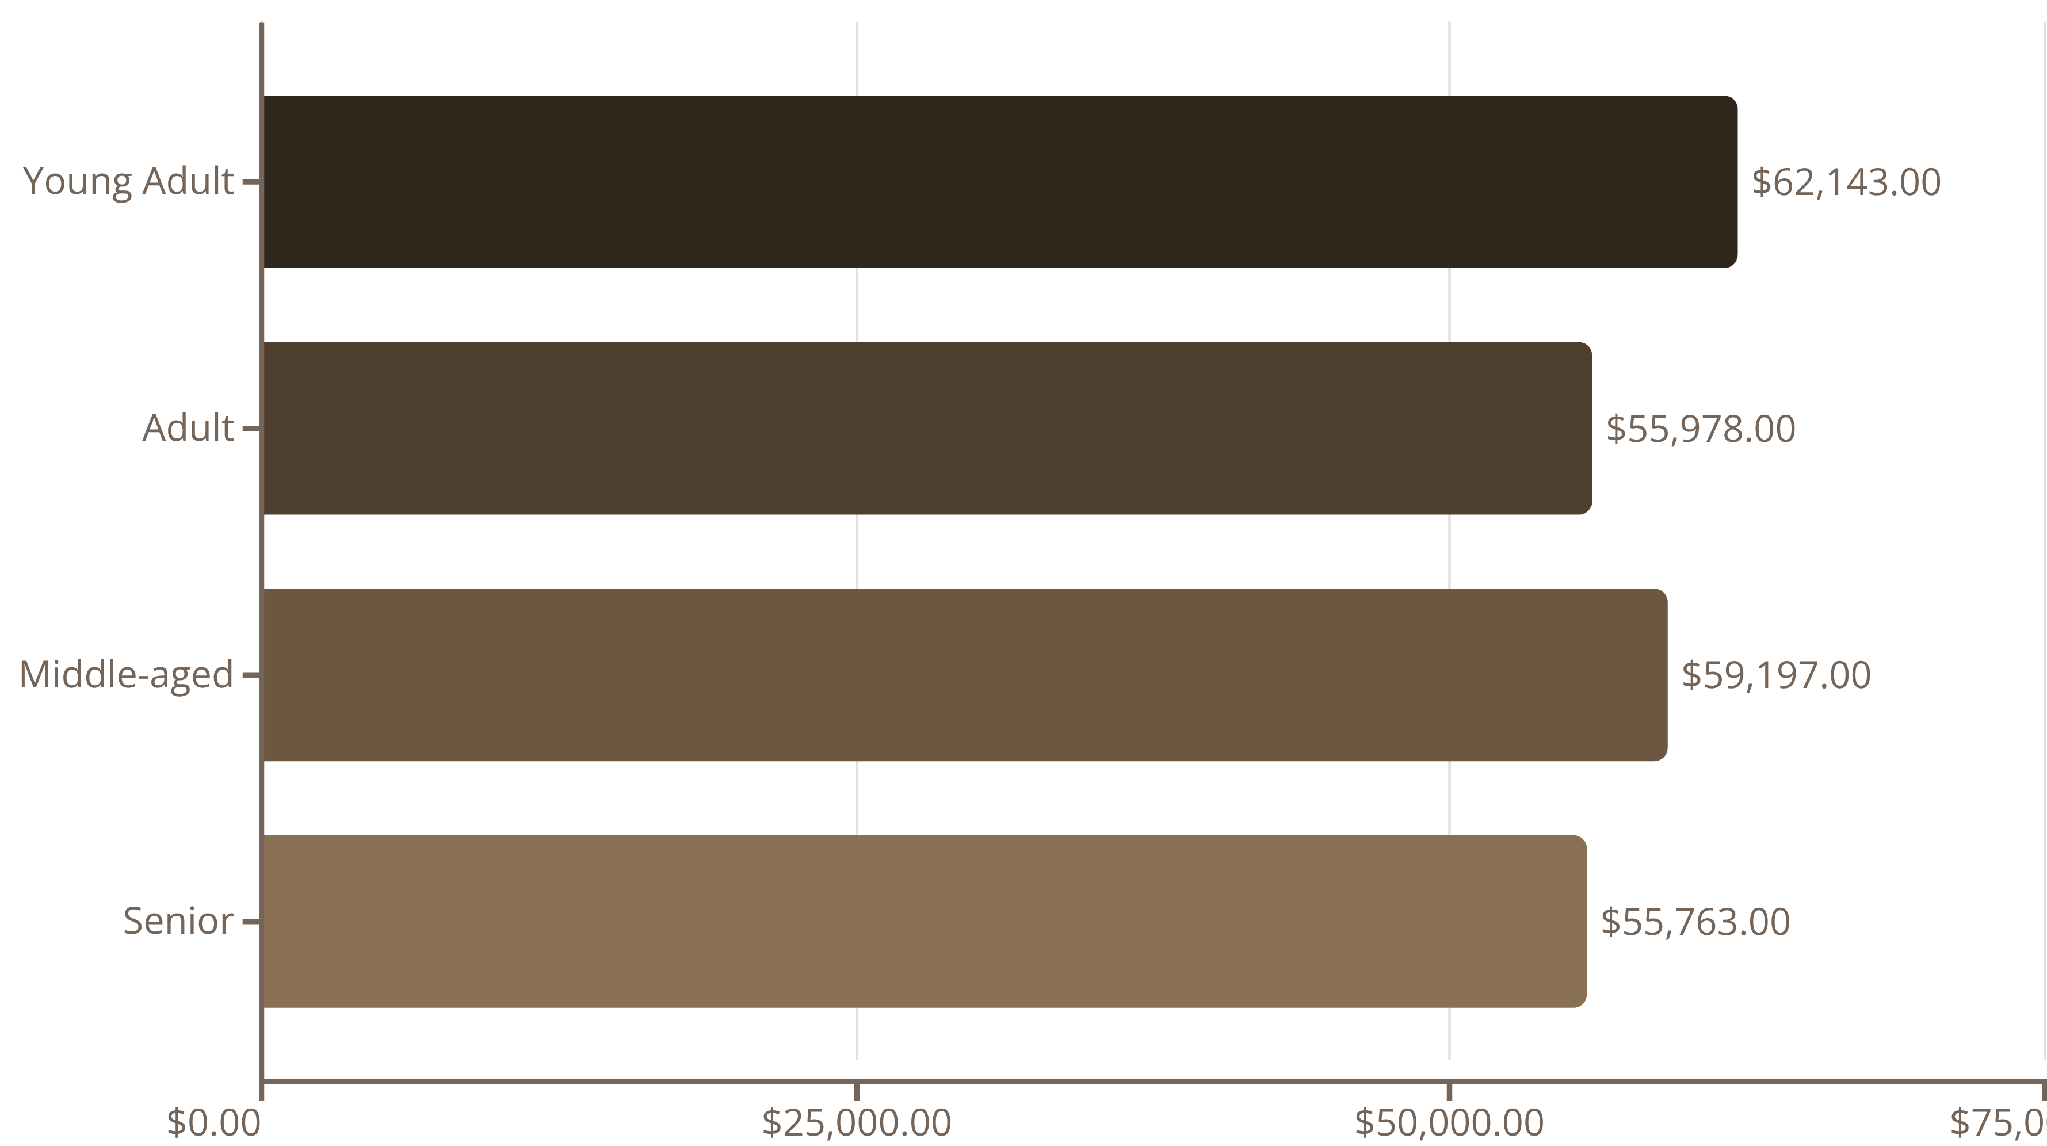
Revenue by Age Group
Young adults lead revenue generation at $62,143, followed closely by middle-aged customers. Revenue distribution is relatively balanced across age groups, suggesting broad market appeal.

Slide 9

Product Performance Insights
Discount-Dependent Products
Top Products by Category
Hat (50% discount rate)
Accessories: Jewelry, Sunglasses, Belt
Sneakers (49.66%)
Coat (49.07%)
Clothing: Blouse, Pants, Shirt
Sweater (48.17%)
Footwear: Sandals, Shoes, Sneakers
Pants (47.37%)
These items rely heavily on promotions to drive sales
Outerwear: Jacket, Coat

Slide 10




Strategic Recommendations
Boost Subscriptions
Promote exclusive benefits to convert 2,518 repeat buyers who aren't subscribed
Loyalty Programs
Reward returning customers to accelerate their journey into the loyal segment
Review Discount Policy
Balance promotional sales with margin control, especially for discount-dependent products
Targeted Marketing
Focus on high-revenue age groups and express-shipping users who spend 3.5% more

